Slide 1
Identification Week 2

Slide 2
What is data?
Notes:
Based on the readings

Slide 3
Data is…
a collection of discrete or continuous values that convey information, describing the quantity, quality, fact, statistics, other basic units of meaning, or simply sequences of symbols that may be further interpreted formally.

Slide 4
Data is…
a collection of discrete or continuous values that convey information, describing the quantity, quality, fact, statistics, other basic units of meaning, or simply sequences of symbols that may be further interpreted formally.

Slide 5
Data is…a collection
What do we mean by collection?

Slide 6
Data is…a collection
What do we mean by collection?
Verb
How is it gathered?
Manually, automatically
Noun
What is the format?
Spreadsheet
Database
Raw vs organized

Slide 7
Data is…a collection of basic units of meaning
What do we mean by basic units of meaning?
Notes:
Here are the examples of types of meaning you could have

Slide 8
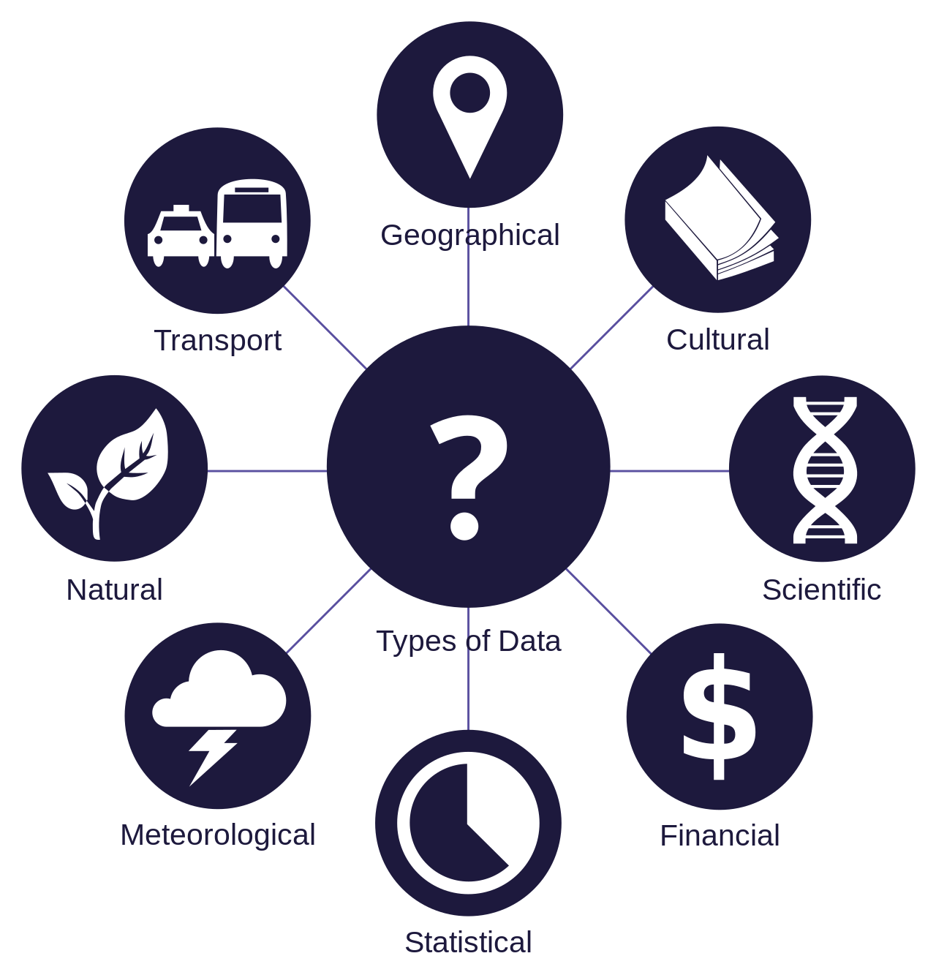
Data is…a collection of basic units of meaning
Notes:
Here are the examples of types of meaning you could have

Slide 9
Data is…a collection of basic units of meaning
Numbers
Words
Dates
Characteristics
Data about the data itself – metadata
Other things?

Slide 10
Data…may be further interpreted formally
What do we mean by this?

Slide 11
Data…may be further interpreted formally
Why use a computer to interpret data?
Fast
Scale
What does analysis look like?
Quantitative vs qualitative
Computers lack nuance
Need careful formatting to analyze
Particularly challenging with humanities stuff!

Slide 12
Altogether…
Data is a collection of basic units of meaning, that may be further interpreted formally.
With that in mind, how does that apply to the thing you produced last week?
What is humanities data, especially?
What have your readings told you?

Slide 13
What is not data?
Notes:
Open discussion based on the readings

Slide 15
Workshop: Data or Not?
Going to show you a series of things
Questions to answer:
Is it data or not?
Why or why not?
If the answer is no, what does it need to become data?
Remember our checklist:
Collection
Of units of meaning
That can be interpreted formally
Notes:
Examples will be…business data, book, spreadsheet, empty spreadsheet, movie poster, series of movie posters, database, collection of sentences, fitbit, phone calls from the NSA

Slide 16
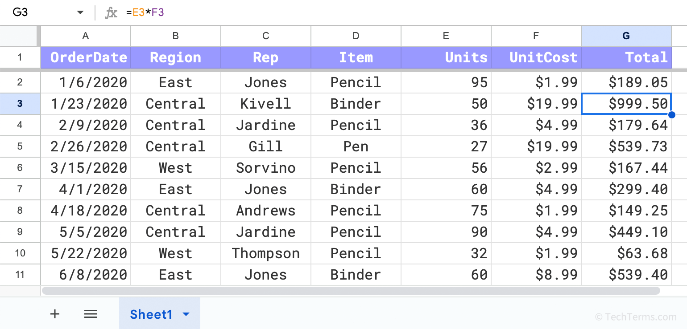
Workshop: Data or Not?
Notes:
From https://techterms.com/definition/spreadsheet

Slide 17
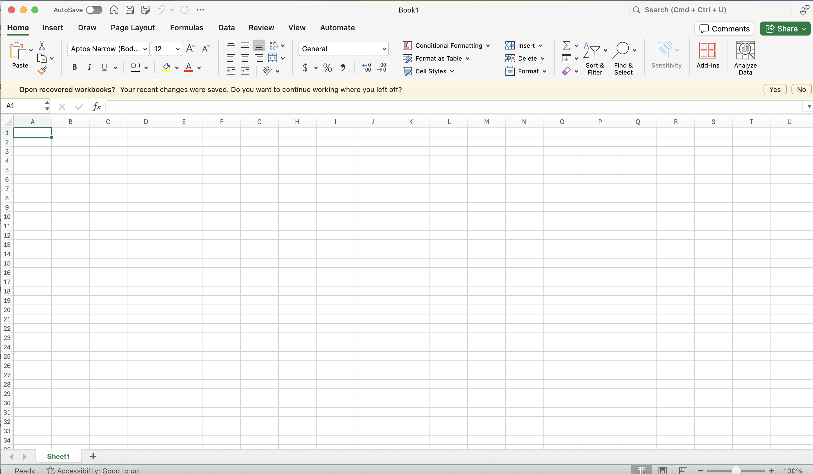
Workshop: Data or Not?
Notes:
Examples will be…business data, book, spreadsheet, empty spreadsheet, movie poster, series of movie posters, database, collection of sentences, fitbit, phone calls from the NSA

Slide 18
Workshop: Data or Not?
Examples will be…book
Notes:
https://unsplash.com/photos/books-on-brown-wooden-shelf-Ft_Wn-K5YH8

Slide 19
Workshop: Data or Not?
Notes:
https://unsplash.com/photos/bible-opened-on-table-Qj3DC6ifJMM

Slide 20
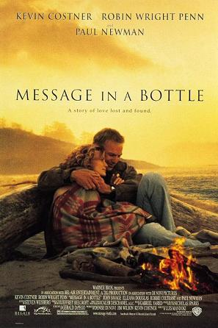
Notes:
Examples will be…business data, book, spreadsheet, empty spreadsheet, movie poster, series of movie posters, database, collection of sentences, fitbit, phone calls from the NSA

Slide 21
Workshop: Data or Not?
Examples will be…series of movie posters
Notes:
https://moviesfilmsandflix.com/2016/06/20/movienomics-analyzing-the-face-palming-world-of-nicholas-sparks-movie-posters/

Slide 22
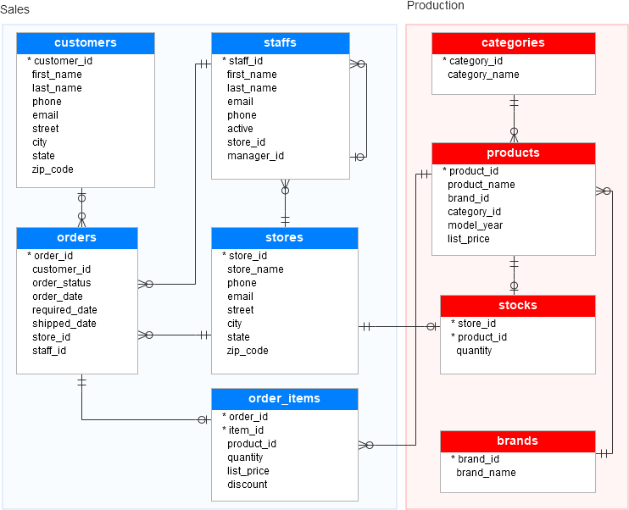
Notes:
https://www.sqlservertutorial.net/getting-started/sql-server-sample-database/

Slide 23
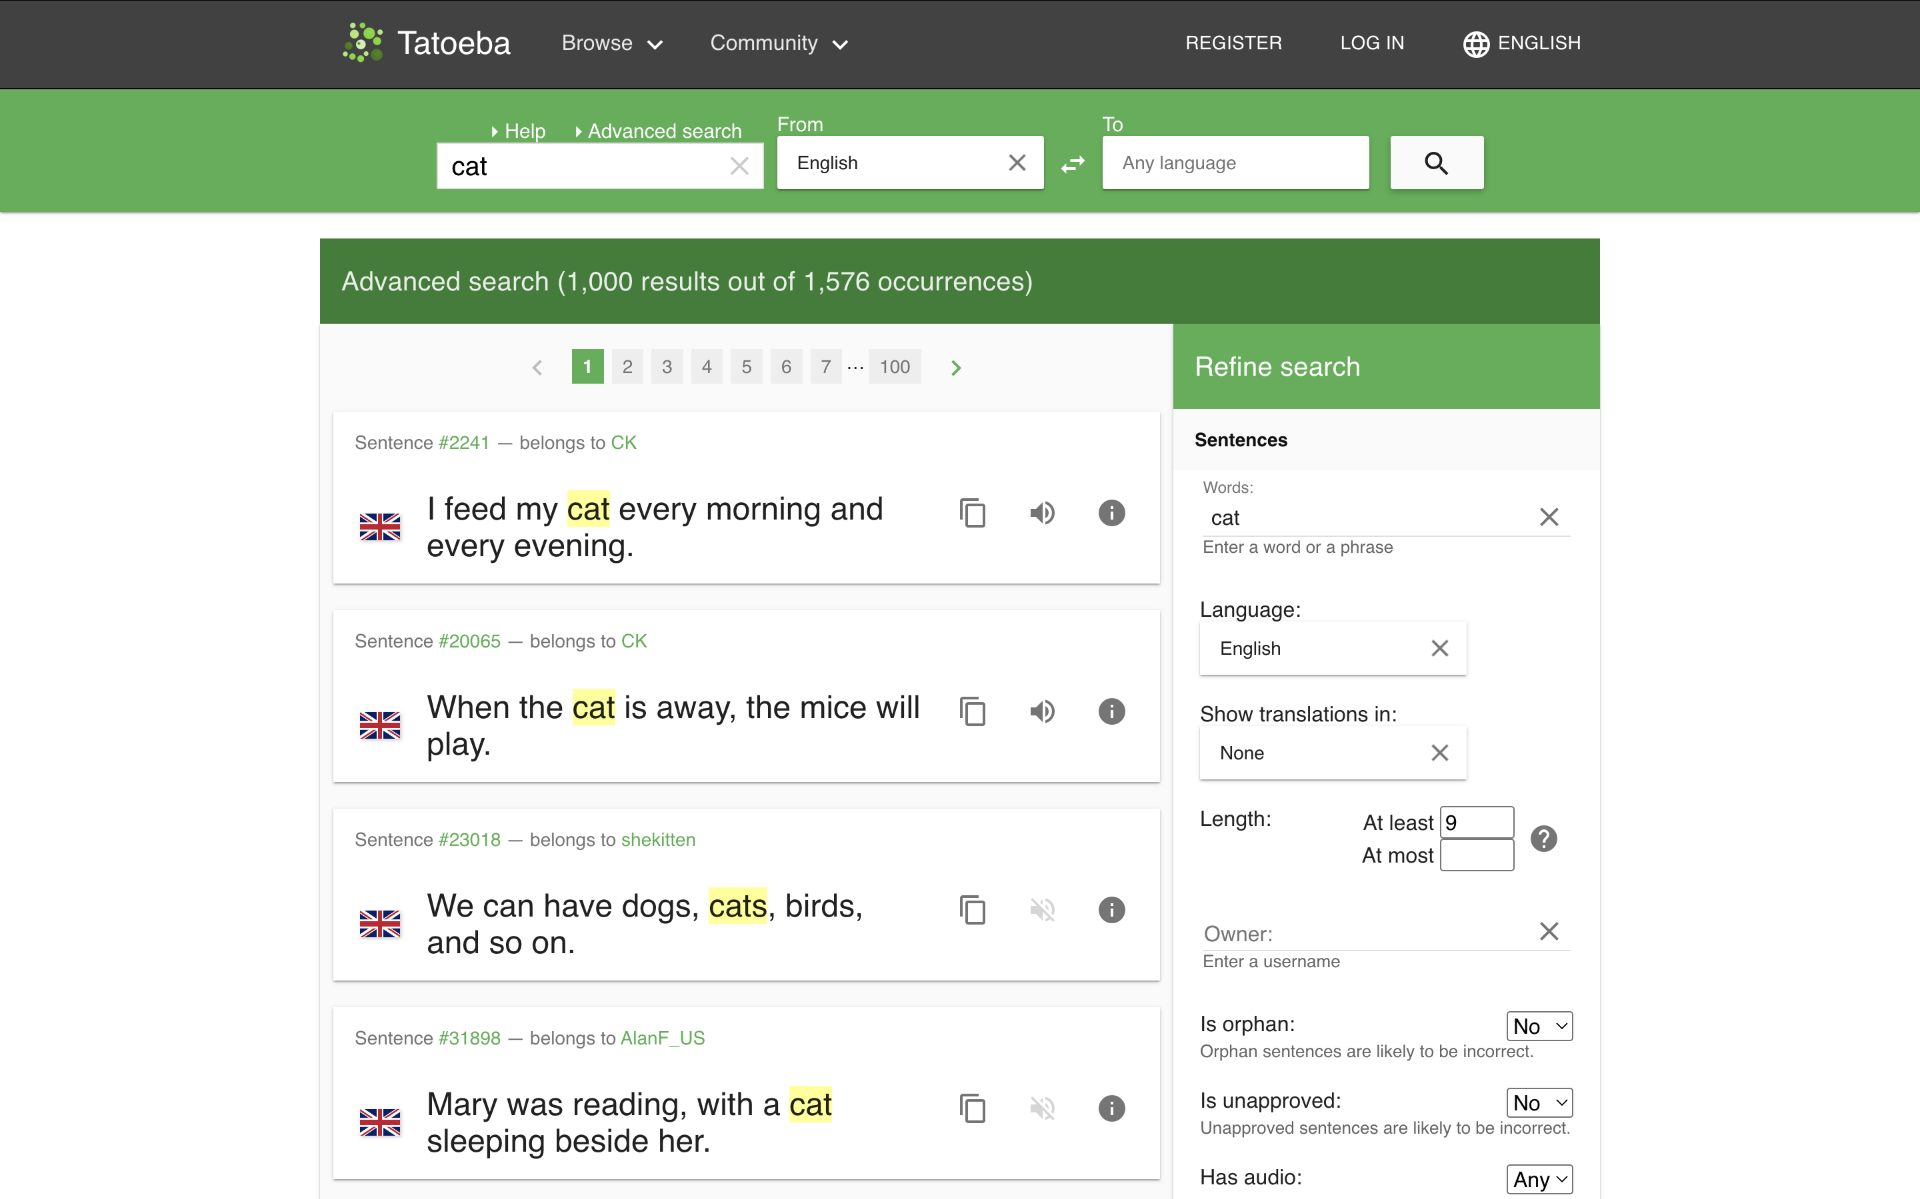
Workshop: Data or Not?
collection of sentences
Notes:
https://tatoeba.org/en/sentences/search?from=eng&has_audio=&native=&orphans=no&query=+cat&sort=relevance&sort_reverse=&tags=&to=none&trans_filter=limit&trans_has_audio=&trans_link=&trans_orphan=&trans_to=&trans_unapproved=&trans_user=&unapproved=no&user=&word_count_max=&word_count_min=9

Slide 24
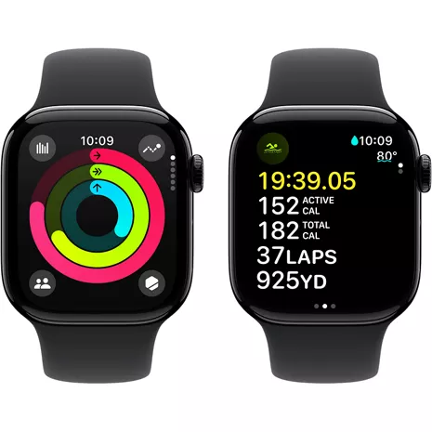
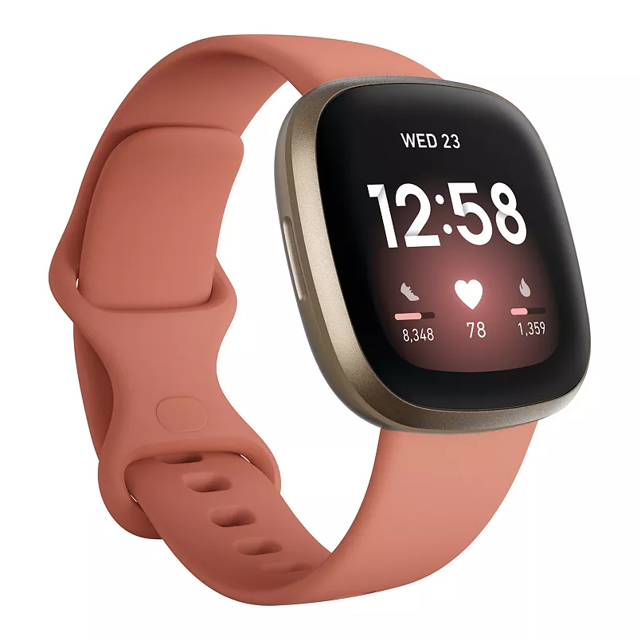
Notes:
Examples will be…business data, book, spreadsheet, empty spreadsheet, movie poster, series of movie posters, database, collection of sentences, fitbit, phone calls from the NSA

Slide 25
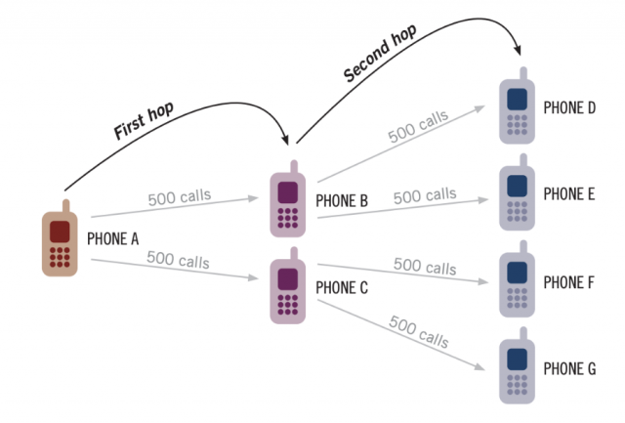
Notes:
https://cdt.org/insights/the-nsa-shuttered-the-call-detail-records-program-so-too-must-congress/

Slide 26
What is missing?
Notes:
Open discussion of the missing datasets
What did they notice?
What kind of personal datasets don’t exist?
How to determine what you can’t see? What kind of ethical considerations are there about making new datasets?
What are some examples of things in your everyday life that you encounter in new and different ways if you can consider them data?
Maybe a bit more time on the missing part here.

