Slide 1
Distribution Week 7

Slide 2
Saving and Distributing – in Pairs
You have a favorite record in your home you want to share with a friend. They’re not the most reliable, and you want to make sure you get it back.
In pairs, write up your detailed plan to share the material, store it until they can receive it, and and make sure it gets back to you.

Slide 3
Distributing Data
Platforms are not all the same!
Helpful to give some instructions for how to use the materials.
Ethical considerations are real
Can you trust them?
What rights do they have?

Slide 4
Pre-Work Discussion
With all this in mind, thoughts on…
Post45 Data Collective
Responsible Datasets in Context
The inspiration for this course!

Slide 6
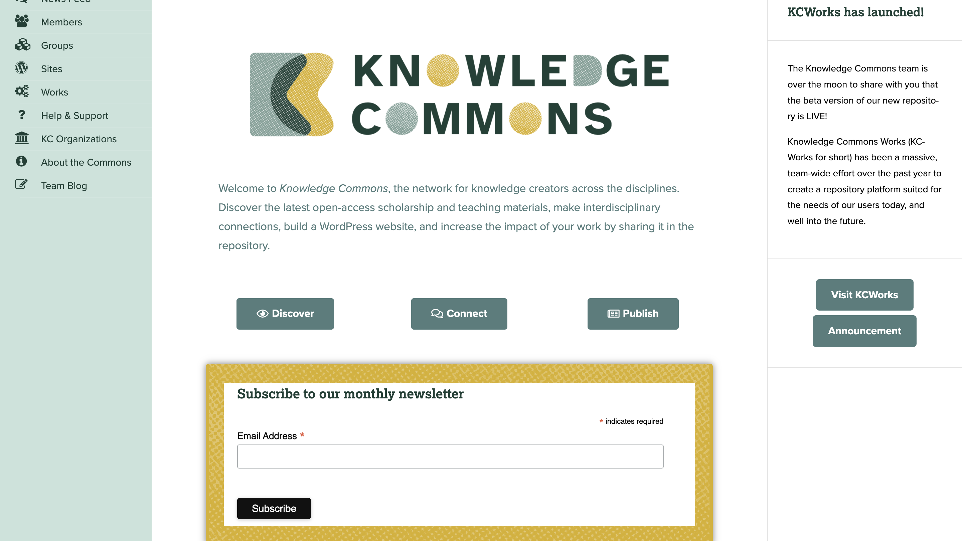

Slide 7
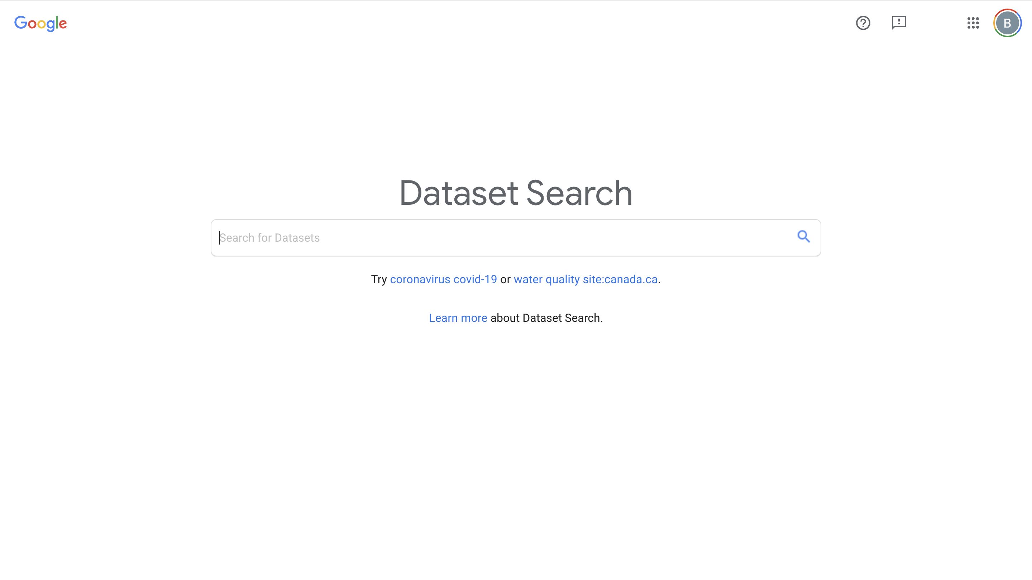

Slide 8
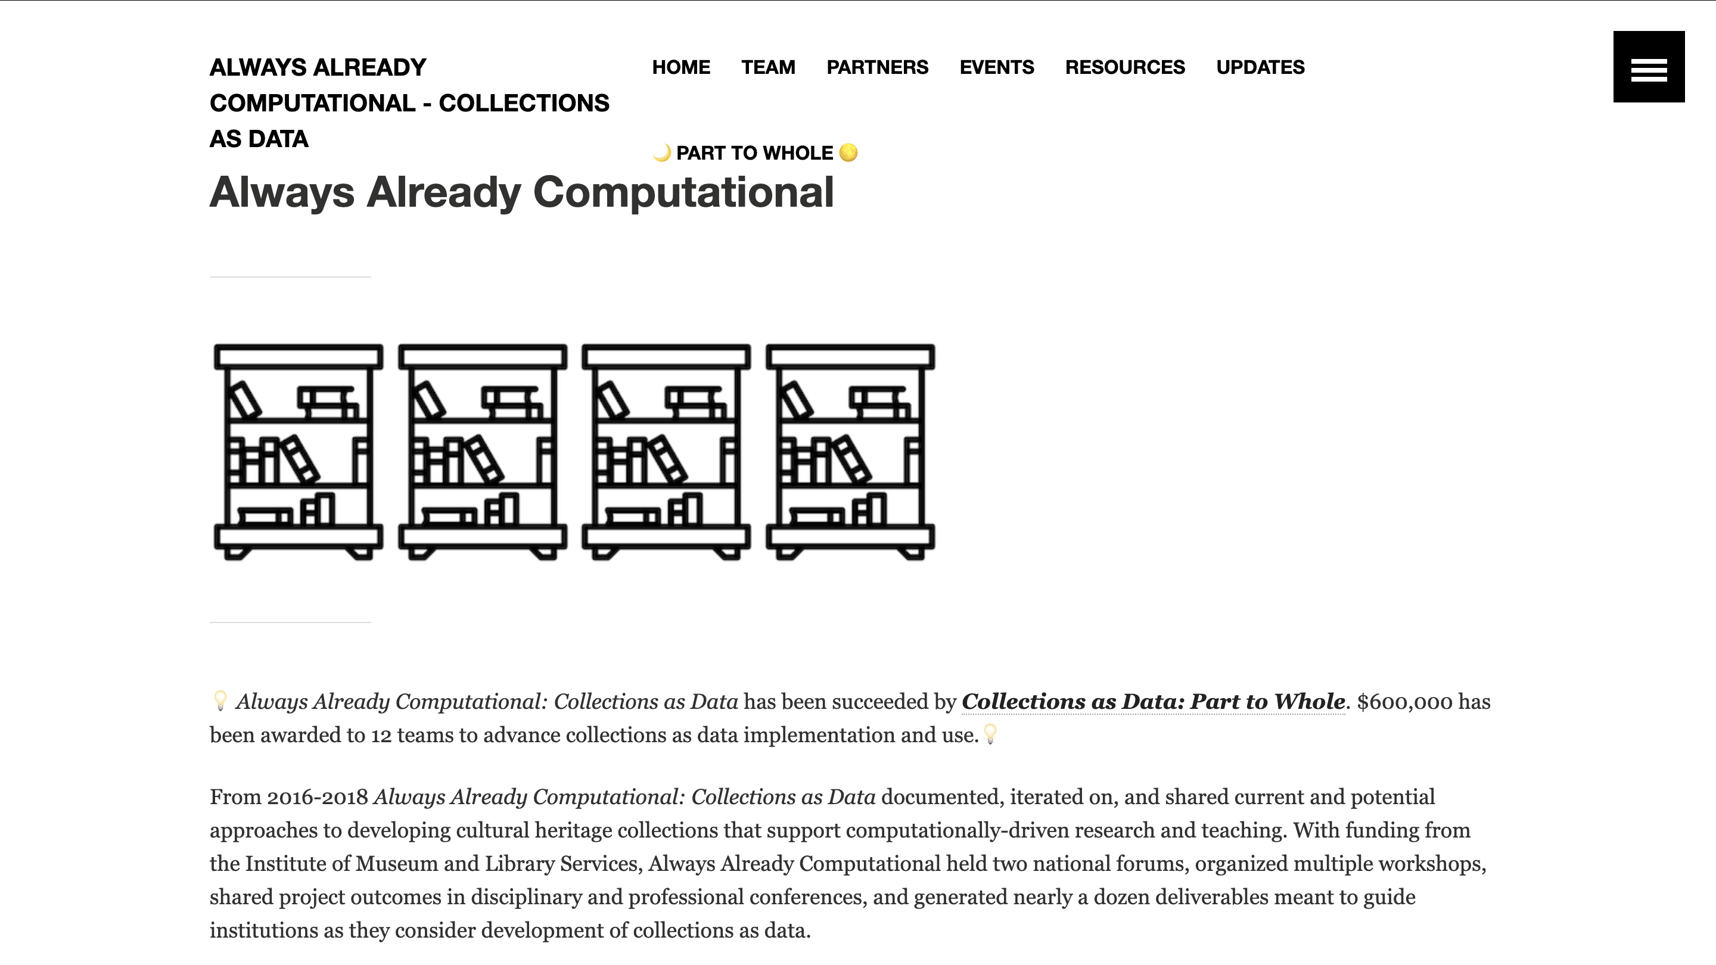

Slide 11
Places to Distribute
Institutional
Knowledge Commons
UVA
Corporate
GitHub (Microsoft)
Google Datasets
Regional
Zenodo (European)
Content Specific
Post 1945 Data Collective
Responsible Datasets in Context
Questions to Consider
Ethics
Rights ownership
Preservation

Slide 12
Documentation
Depositing is not enough!
Describe the work that you did so others can use it.
Can involve…
Metadata description
Narrative and context for the materials
Example use cases
Teaching materials

Slide 13
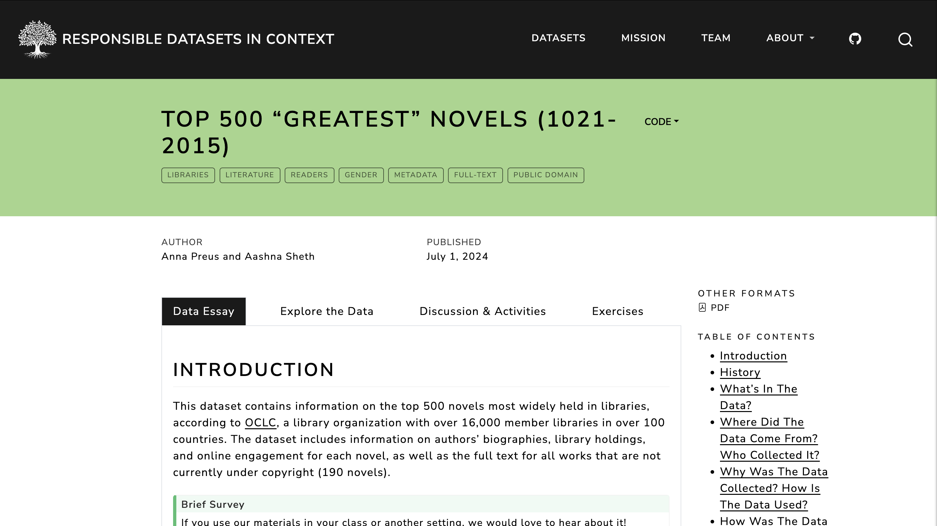

Slide 15
Crash Course in Copyright and Licensing

Slide 16
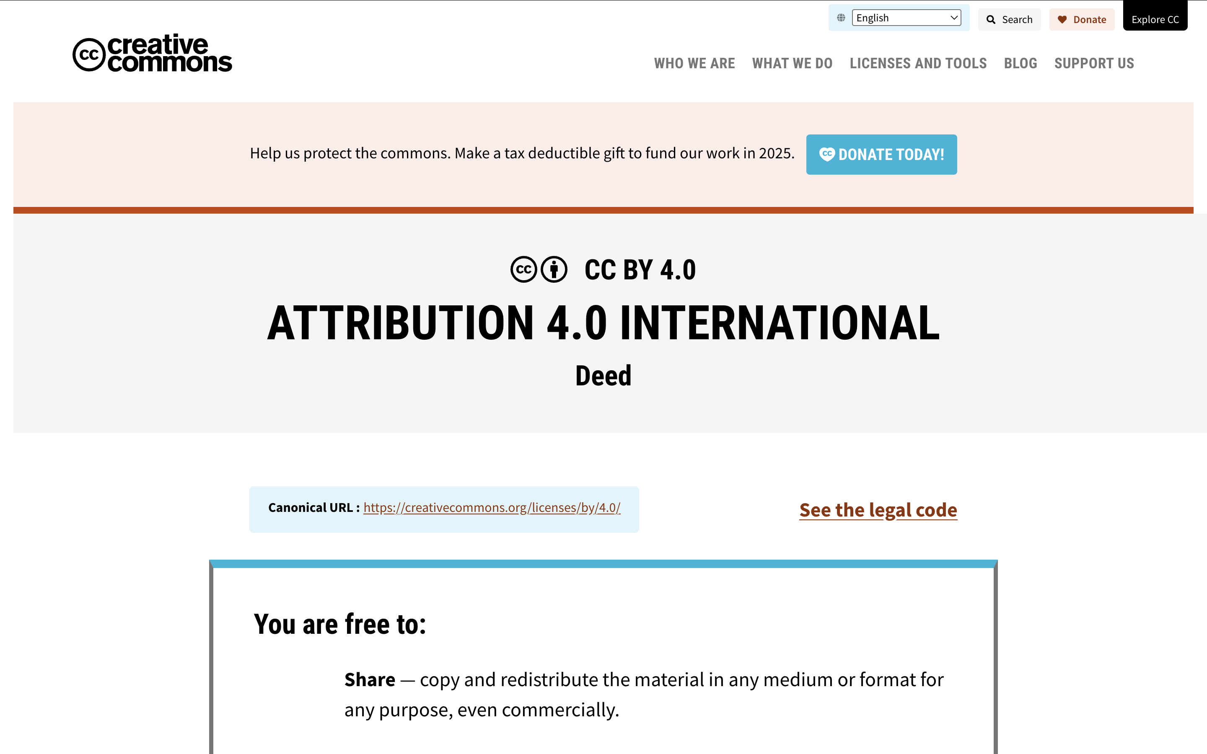
Creative Commons Crash Course
Select basic copyright terms for your work
Can it be reused?
Do you require attribution?
For commercial purposes?
I use CC By

Slide 17
Make a Data Plan – pairs or as small groups
Make a data sharing plan for your original class dataset.
What would you share? How?
What would you not share?
What rights would you give it?
What documentation would you provide?
What stories would you encourage others to tell with it?
Notes:
For remaining time

Slide 18
All of this is the Model for your Final Project!
Task is to follow the steps of the course units to create a dataset
Outcome will look like these examples
Includes:
Collected, cleaned Data
Metadata breakdown
Narrative of the dataset
Usage examples
Basic analysis
Credits

